Slide 1

Unit V – Cloud Applications
Scientific Applications using Cloud Computing
Cloud Computing in Health Care
Cloud Computing in Geo-Science
Cloud Computing in Biology
Cloud Computing
Mr. Vijay Kolte

Slide 2
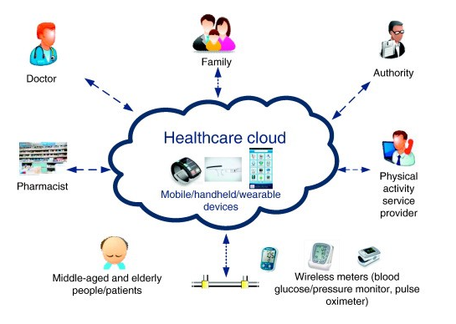
Unit V – Cloud Applications
Cloud Computing in Health Care
Notes:
Today the application of cloud computing is so widespread that it is being used even in the health care industry.
As the evolution of cloud computing in health care is occurring at a rapid rate in recent times, we can expect a major part of the healthcare services to move onto the cloud and thereby more focus is laid on providing a cost effective and efficient healthcare service to the people all around the globe.
Despite of a common belief that certain boundaries and security issues of the cloud would hinder the shift, the healthcare industry is taking an initiative to move to these cloud-based platforms.
Today many doctors and hospitals are moving towards these clouds in order to provide better healthcare services to their patients.

Slide 3
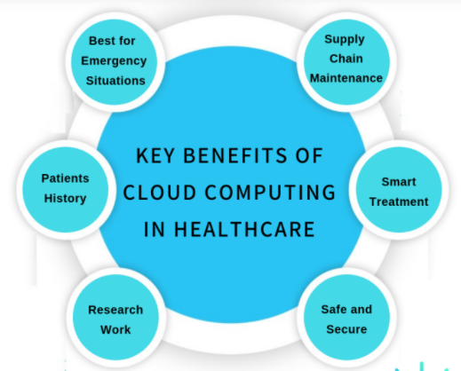
Unit V – Cloud Applications
Cloud Computing in Health Care

Slide 4
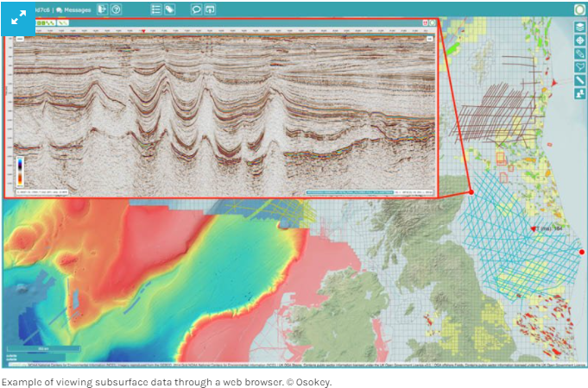
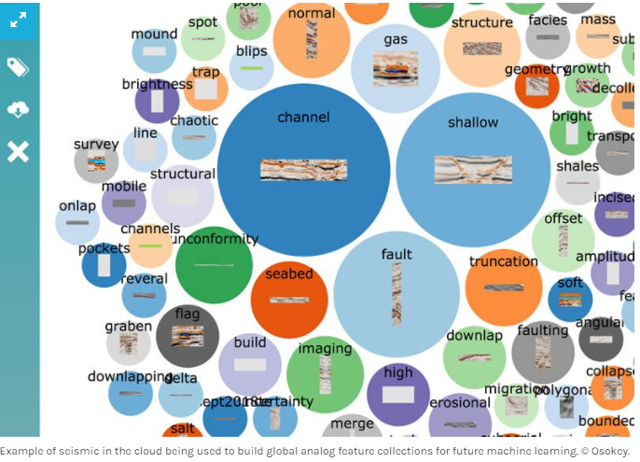
Unit V – Cloud Applications
2. Cloud Computing in Geoscience
Notes:
Within geoscience, the technical workflow is well established. There are clear ways to utilize the geoscientist’s knowledge and domain expertise to deliver subsurface evaluations. From time to time a new method may be incorporated, but overall, the workflow remains relatively constant. Compare that to the rate of change of technology across all industries. What if we could harness some of these exciting new technologies and apply them to our workflows? With cloud technology, that possibility starts to become a reality.

Slide 5
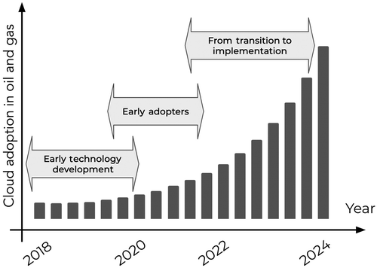
Unit V – Cloud Applications
2. Cloud Computing in Geoscience
Notes:
Cloud computing has become an integral part of our daily life and work. In the oil and gas industry, cloud computing is becoming increasingly attractive to experts, operators, and software companies. However, we believe that there is still some level of mystery for many geoscientists in what cloud computing can actually offer, what the pros and cons are, and how it is different from the preceding technologies.

Slide 6
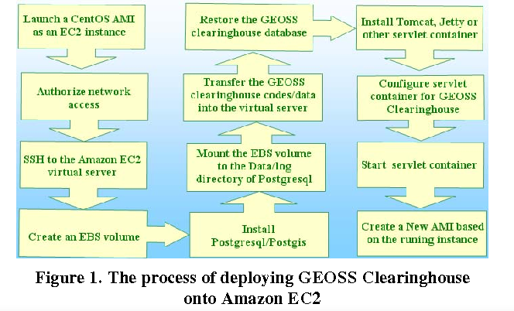
Unit V – Cloud Applications
2. Cloud Computing in Geoscience
Notes:
To test the utilization of cloud computing for Geosciences applications, the GEOSS(Global Earth Organization) clearinghouse was deployed, maintained and tested on the Amazon Elastic Cloud Computing (EC2) platform. The GEOSS Clearinghouse is a web-based Geographic Metadata Catalog System, which manages millions of the metadata of the spatially referenced resources for the Global Earth Observations (GEO). Our experiment reveals that the EC2 cloud computing platform facilitates geospatial applications in the aspects of a) scalability, b) reliability, and c) reducing duplicated efforts among Geosciences communities. Our test of massive data inquiry by concurrent user requests proves that different applications should be justified and optimized when deploying onto the EC2 platform for a better balance of cost and performance.

Slide 7
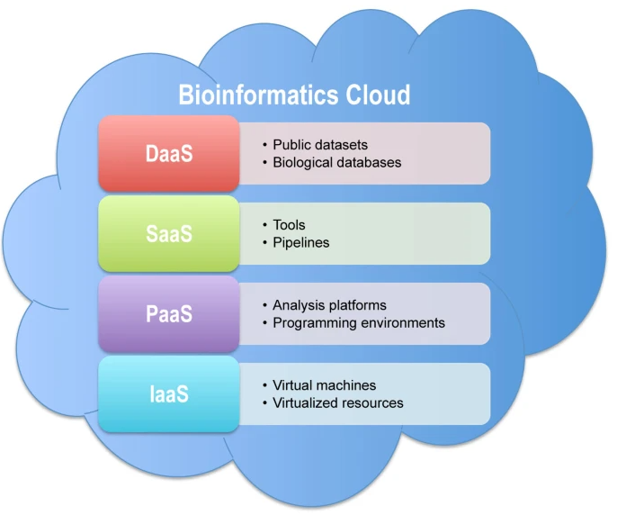
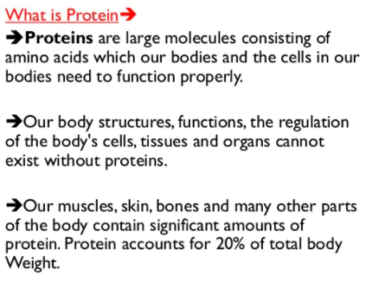
Unit V – Cloud Applications
3. Cloud Computing in Biology
Notes:
Cloud Biology is a system that combines data, machine learning and AI techniques with biological sciences. “It accelerates breeding by enabling greater precision and fewer breeding cycles.
Applications in biological research and future prospects. ... Large datasets and applications for image analysis, data mining, protein folding, and gene sequencing can also be shared for collaborative research between facilities using clouds. This is a simpler approach than transferring such data.

Slide 8
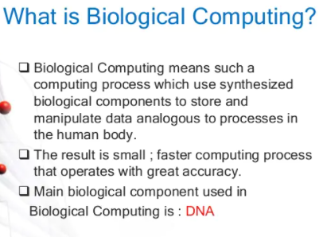
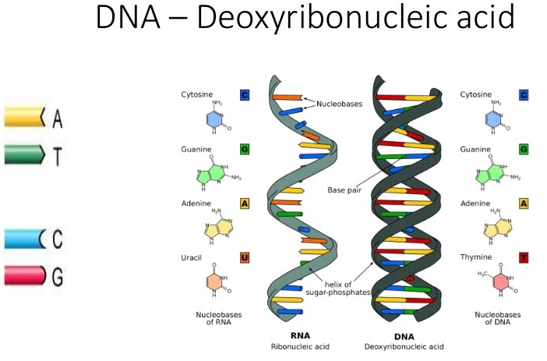
Unit V – Cloud Applications
3. Cloud Computing in Biology

Slide 9
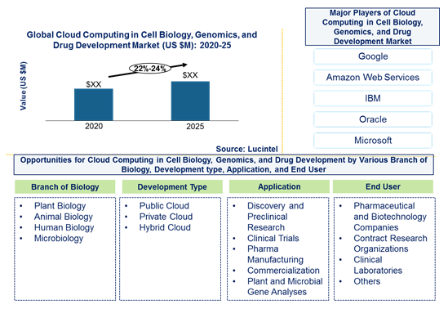
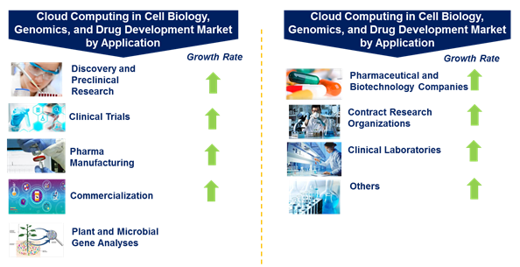
Unit V – Cloud Applications
3. Cloud Computing in Biology
Notes:
In this market, discovery & preclinical research is the largest application of cloud computing in cell biology, genomics, and drug development, whereas pharceutical and biotechnology companies is the largest end user. Growth in various segments of the of cloud computing in cell biology, genomics, and drug development market are given below

Slide 10
Unit V – Cloud Applications
Business & Consumer Applications using Cloud Computing
CRM Application (Customer Relationship Management)
ERP Application (Enterprise Resource Planning)
Notes:
CRM stands for Customer Relationship Management and is a software that is hosted in cloud so that the users can access the information using internet. CRM software provides high level of security and scalability to its users and can be easily used on cell phones to access the data.

Slide 11
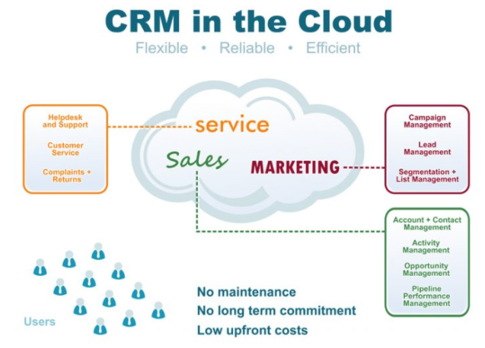
Unit V – Cloud Applications
CRM Application (Customer Relationship Management)
CRM on premise vs. CRM on cloud
On premise, software involves storing all your data in servers stored at your office location hence CRM on premise cost is high.
CRM on cloud price is less as it involves storing the information in cloud-based servers which can be accessed at any time and from any location.
CRM on cloud services solution can be scaled as per your requirement. All the data is stored at a central point and is in reach for all the people involved.

Slide 12
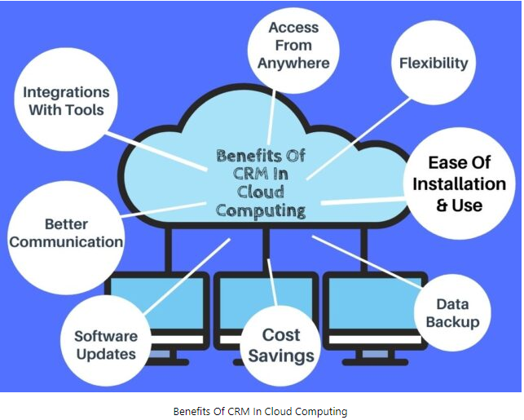
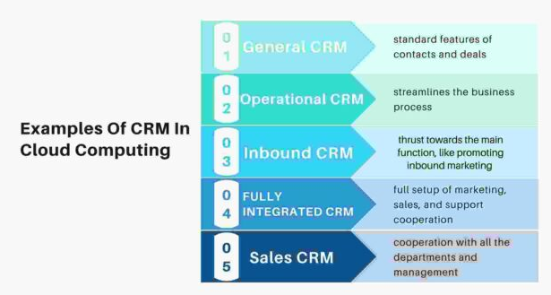
Unit V – Cloud Applications
CRM Application (Customer Relationship Management)

Slide 13
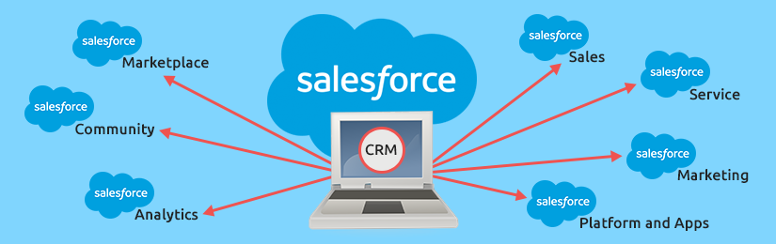
Unit V – Cloud Applications
CRM Application (Customer Relationship Management)

Slide 14
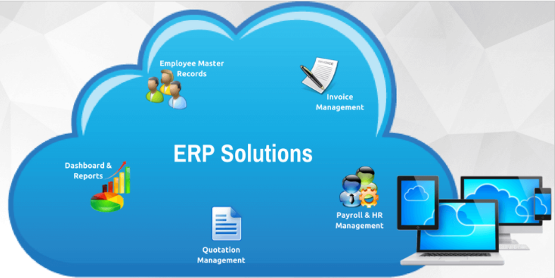
Unit V – Cloud Applications
2. ERP Application (Enterprise Resource Planning)
Notes:
Almost every company has ERP (Enterprise Resource Planning) software to connect all the financial, operational and accounts data in a seamless manner. However, it seems too expensive for some companies especially the growing companies as when the company grows, excessive complexity arises in the management of all the data from different departments. Therefore, many companies are now shifting their on-premises ERP to the cloud. In the digital age, cloud computing services are already in huge demand and although there are many big names who provide such solutions, Microsoft is the most prominent one. Its ERP suite Microsoft Dynamics GP is now available from the server to cloud.

Slide 15
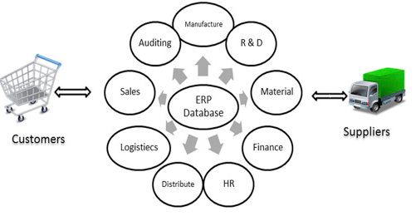
Unit V – Cloud Applications
2. ERP Application (Enterprise Resource Planning)

Slide 16
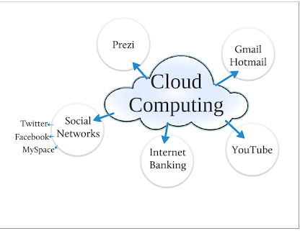
Unit V – Cloud Applications
Business & Consumer Applications using Cloud Computing
3. Social Networking
4. Media Applications

Slide 17
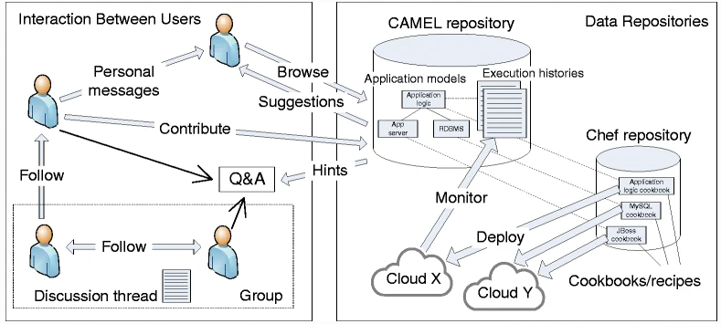
Unit V – Cloud Applications
Business & Consumer Applications using Cloud Computing
Notes:
Social networks help boost internet usability by storing heavy multimedia content in cloud storage systems. Videos and photographs are the most popular content on social media, which essentially use up the maximum space allocated to them. They have the capacity to slow down applications and servers with all of their resource demands. Cloud computing vendors such as Salesforce and Amazon nowadays provide varied services including Customer Relationship Management (CRM) and Enterprise Resource Planning (ERP). As they deliver these things through cloud servers, clients can use the flexibility and scalability of the system without purchasing standalone software or hardware.

Slide 18
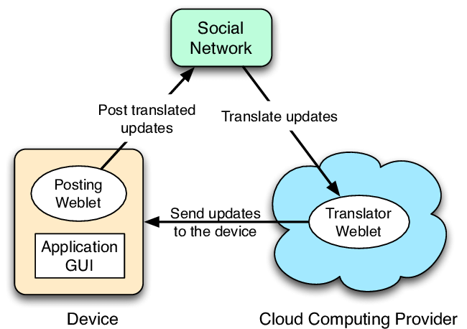
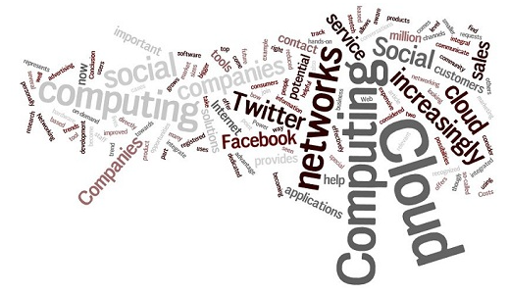
Unit V – Cloud Applications
Business & Consumer Applications using Cloud Computing

Slide 19
Unit V – Cloud Applications
Business & Consumer Applications using Cloud Computing
Media Applications
What is cloud computing in media?
Cloud computing is helping media companies to significantly reduce storage costs, eliminate the need to move assets between locations and organize seamless internal and external workflows, complete with robust network security, data encryption and access management.
Why are media companies adopting the cloud?
By leveraging cloud infrastructure solutions, SaaS gives new digital capacities to media companies as their work processes demand, which efficiently balances load across the provisioned capacity. The combination of auto-scaling, load-balancing and multi-tenancy makes SaaS valuable for media companies.

Slide 20
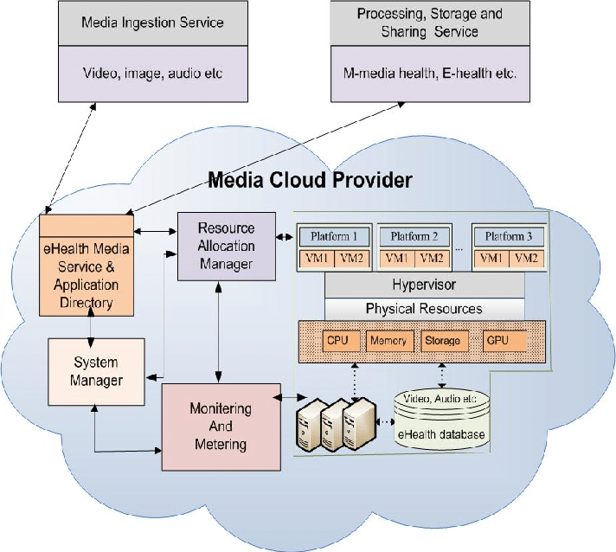
Unit V – Cloud Applications
Business & Consumer Applications using Cloud Computing

Slide 21
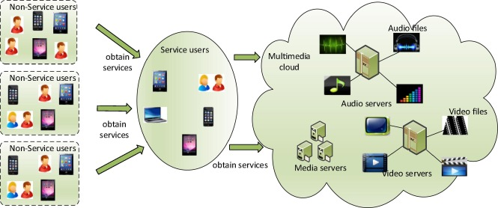
Unit V – Cloud Applications
Business & Consumer Applications using Cloud Computing

